Slide 1
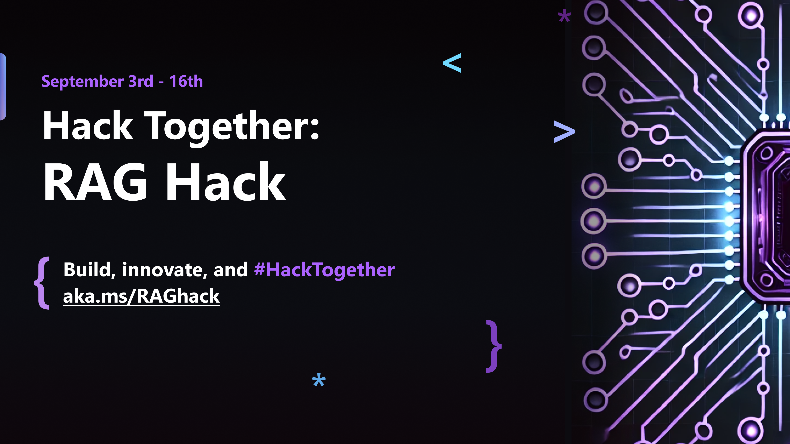

Slide 2
Spring AI + RAG: Feel the Power
Mark Heckler
Principal Cloud Advocate, Java/JVM Languages
markheckler@microsoft.com
@mkheck

Slide 3
Agenda
Quick review of AI concepts
The value prop 🌟
Implementation options
Action! 🎬
Code repo/helpful links

Slide 4
AI concepts
Large Language Models (LLMs)
Purposes: specific vs. general
Sizes
Providers
Local vs. cloud-based
Retrieval Augmented Generation (RAG)
Embeddings
Vector stores
Language frameworks
Semantic Kernel*
Langchain4j*
Spring AI
* Not in scope for this session, check back for more
Notes:
Why are language frameworks being discussed under AI concepts? They’re integral to leveraging AI due:
Useful, higher-level abstractions
Resulting in increased developer capabilities
And insulating from implementation details to the extent possible/practical
While still allowing devs to avail themselves of the power

Slide 5
The value prop 🌟
Unleash an AI on your data

Slide 6
Implementation options
Local
Container runtimes/execution engines, e.g. Docker, Ollama, et al.
Pros: Variety, “zero” cost
Cons: Resource intensive, sometimes painfully so
Cloud-based
Various vendors, outlets
Pros: POWER! 🔋 SPEED! 🏎️
Cons: Costs*
Application deployment**
* Only you can determine if this is a factor or not, case-specific
** Not in scope for this session, check back for more

Slide 7

Action! 🎬

Slide 8
Code repo/reference links
Show me the code!
https://github.com/mkheck/rag
Current samples include:
Azure OpenAI + Azure AI Search
OpenAI + Chroma
Llama + Chroma
(more to follow)
Helpful links
Spring AI docs
OpenAI docs
Azure OpenAI docs
Azure pricing calculator
Ollama
Notes:
Why are language frameworks being discussed under AI concepts? They’re integral to leveraging AI due:
Useful, higher-level abstractions
Resulting in increased developer capabilities
And insulating from implementation details to the extent possible/practical
While still allowing devs to avail themselves of the power

Slide 9
Thank you!

